Slide 1
Regular Expression
Search patterns

Slide 2
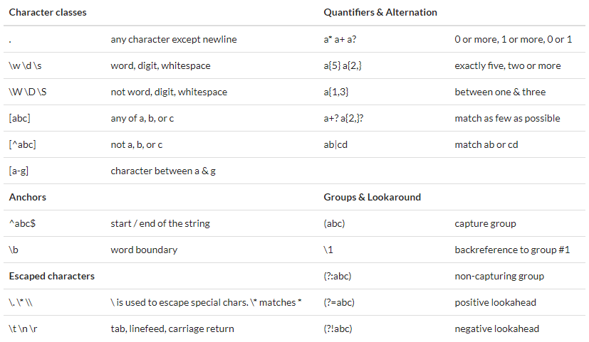
Cheat sheet

Slide 3
Common regex (1)
1.Common email
/^([a-zA-Z0-9._%-]+@[a-zA-Z0-9.-]+\.[a-zA-Z]{2,6})*$/
2. Whole Numbers: /^\d+$/
Decimal Numbers: /^\d*\.\d+$/
Whole + Decimal Numbers: /^\d*(\.\d+)?$/
Negative, Positive Whole + Decimal Numbers
/^-?\d*(\.\d+)?$/
Whole + Decimal + Fractions
/[-]?[0-9]+[,.]?[0-9]*([\/][0-9]+[,.]?[0-9]*)*/

Slide 4
Common regex (2)
3. Alphanumeric without space – /^[a-zA-Z0-9]*$/
Alphanumeric with space – /^[a-zA-Z0-9 ]*$/
4.Password Strength
Complex: Should have 1 lowercase letter, 1 uppercase letter, 1 number, 1 special character and be at least 8 characters long
/(?=(.*[0-9]))(?=.*[\!@#$%^&*()\\[\]{}\-_+=~`|:;"'<>,./?])(?=.*[a-z])(?=(.*[A-Z]))(?=(.*)).{8,}/
Moderate: Should have 1 lowercase letter, 1 uppercase letter, 1 number, and be at least 8 characters long
/(?=(.*[0-9]))((?=.*[A-Za-z0-9])(?=.*[A-Z])(?=.*[a-z]))^.{8,}$/

Slide 5
Common regex (3)
5. Username
Alphanumeric string that may include _ and – having a length of 3 to 16 characters –
/^[a-z0-9_-]{3,16}$/
6. URL
Include http(s) Protocol
/https?:\/\/(www\.)?[-a-zA-Z0-9@:%._\+~#=]{2,256}\.[a-z]{2,6}\b([-a-zA-Z0-9@:%_\+.~#()?&//=]*)/
Protocol Optional
/(https?:\/\/)?(www\.)?[-a-zA-Z0-9@:%._\+~#=]{2,256}\.[a-z]{2,6}\b([-a-zA-Z0-9@:%_\+.~#?&//=]*)/

Slide 6
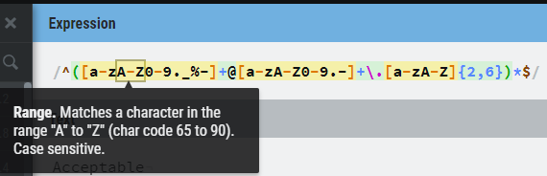
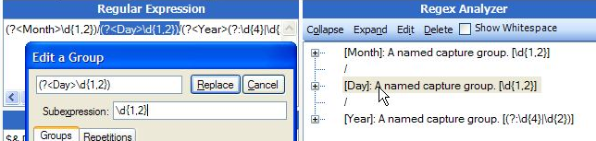
Tools for beginner
regexr.com
Expresso
  http://www.ultrapico.com/ExpressoDownload.htm

Slide 7
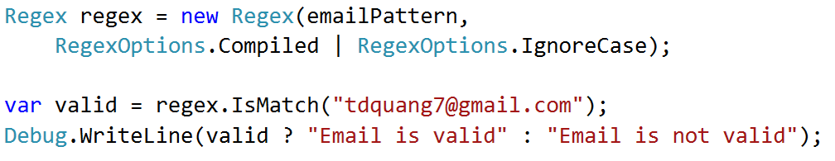
Regex class in C#

Slide 8
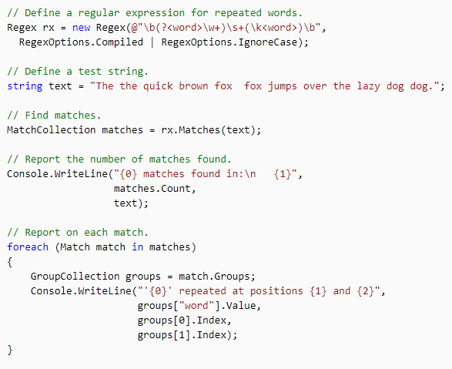
Find repeated words

